Slide 1
Assignment #2
OSPF Packet Capture

Slide 2
Assignment #2 – OSPF Packet Capture
Purpose of this assignment
Understanding OSPF router data structure
Understanding OSPF Packet exchange flow
Understanding how routing information database is synchronized among routers.
Submission (Due date is 2020/6/25)
Report the OSPF router data structure and captured OSPF Packets based on the router data structure
* Report must include sufficient explanation for packet contents and corresponding OSPF router structure
* If you write value only without explanation on the report, you will get extremely low mark.
Screen captures (the router data structure – use ospfd_mon)
Captured packet file (Use wireshark save.)

Slide 3
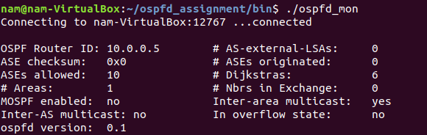
Example
Example OSPF Router Data structure
1. The router’s data structure shown by ospfd_mon

Slide 4
Example
Example OSPF Router Data structure
2. You must explain why the data structure is like the above.
It is the per-router data structure defined OSPF standard
EXAMPLE: router id (first field)
router ID value and definition (the 32-bit unique identifier of a router within the AS)
We define the router id at the ospfd.conf configuration file as
routerid 10.0.0.5.
It is used at
the router id field in the OSFP packet header
neighbor id at “hello” packets’ neighbor list
the advertising router id at the router-LSA
the link state ID at the router-LSA
the link ID field of the point-to-point link in the router LSA

Slide 5
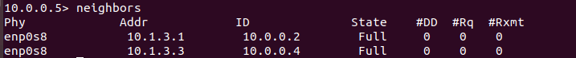
ospfd_mon commands
See the ospf_mon.jpg or ospf_mon>help
areas
interfaces
neighbors
database
adv
routes
etc.

Slide 6
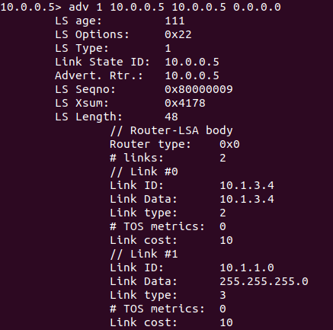
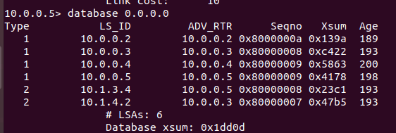
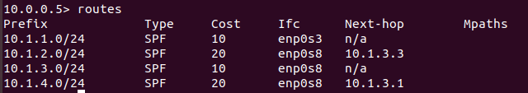
ospfd_mon commands
database <Area ID>
adv <LS-Type> <Link State ID> <Advertising Rtr ID> <Area ID>

Slide 7
Environment Setup
Network Topology
Subnet
Interface IP address
10.1.2.0/24
VM3
10.0.0.4
10.1.2.3
(VM Number)
(Router ID)
Router Name
and ID
10.1.3.3
10.1.3.0/24
VM1
10.0.0.2
10.1.4.0/24
10.1.3.1
10.1.4.1
10.1.3.4
10.1.4.2
10.1.1.0/24
VM4
10.0.0.5
VM2
10.0.0.3
10.1.1.4

Slide 8
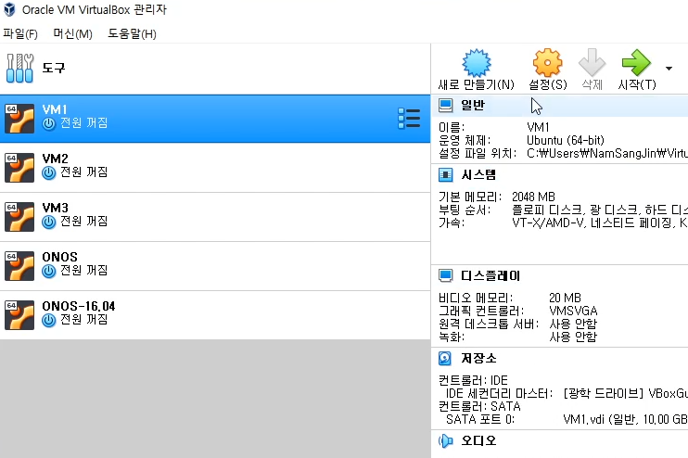
Environment Setup

Slide 9
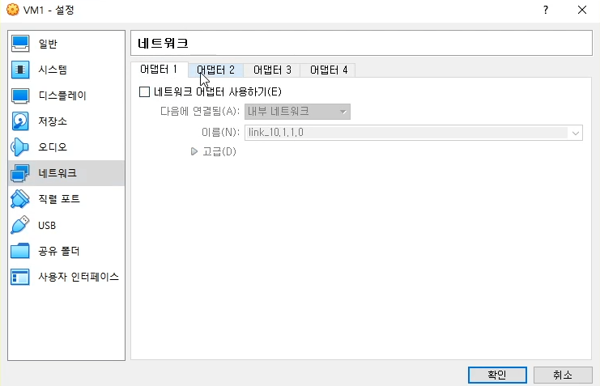
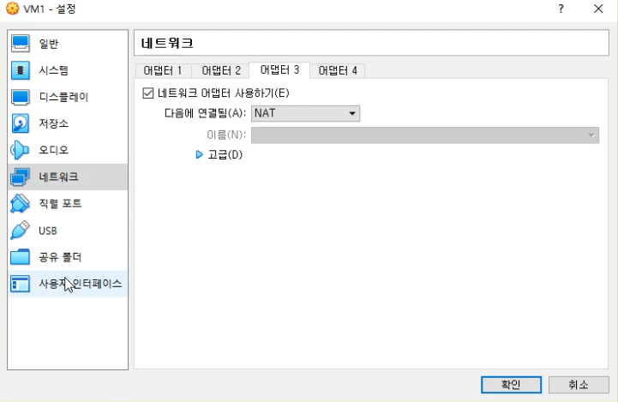
Environment Setup
Uncheck adapter(s) for inner network and check another adapter and select NAT

Slide 10
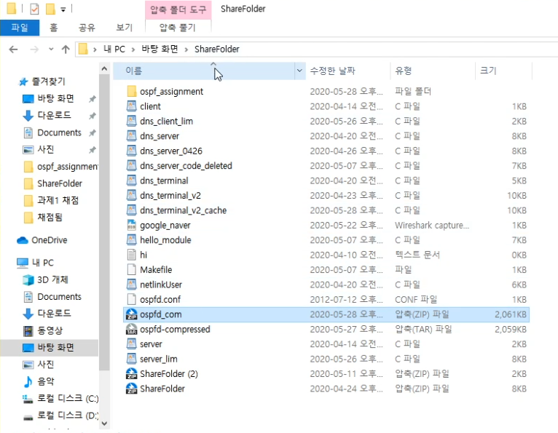
Environment Setup
Place ospfd_com in ShareFolder
(shared folder on Windows)

Slide 11
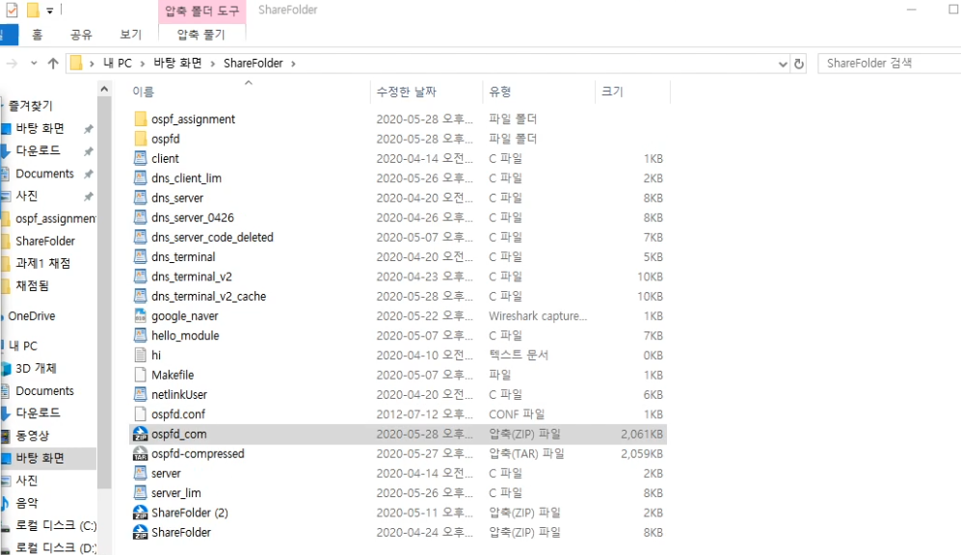
Environment Setup
Decompress ospfd_com.
Check whether ospfd and ospfd.conf is made both.

Slide 12
Environment Setup

Slide 13
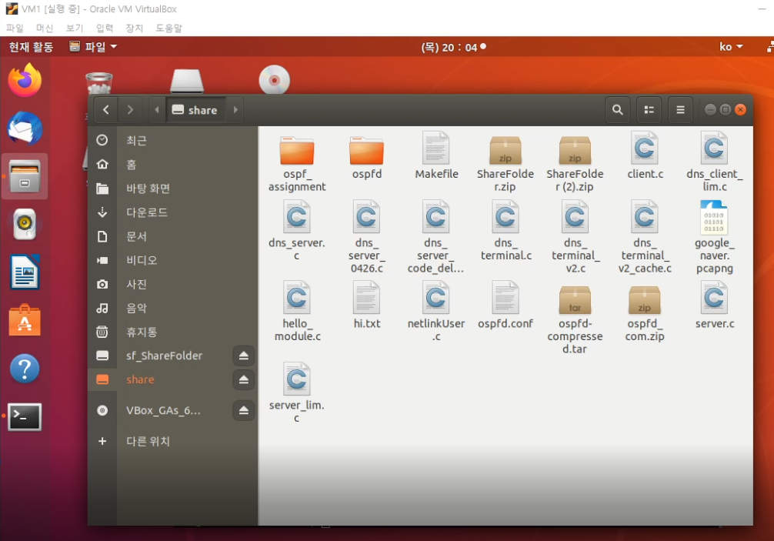
Environment Setup
3
Click
1
Click
2
Select one folder and one file, ospfd and ospfd.conf
Press Ctrl + C

Slide 14
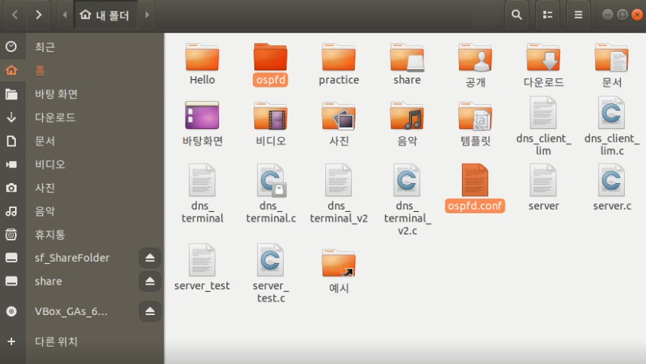
Environment Setup
Ctrl + V

Slide 15
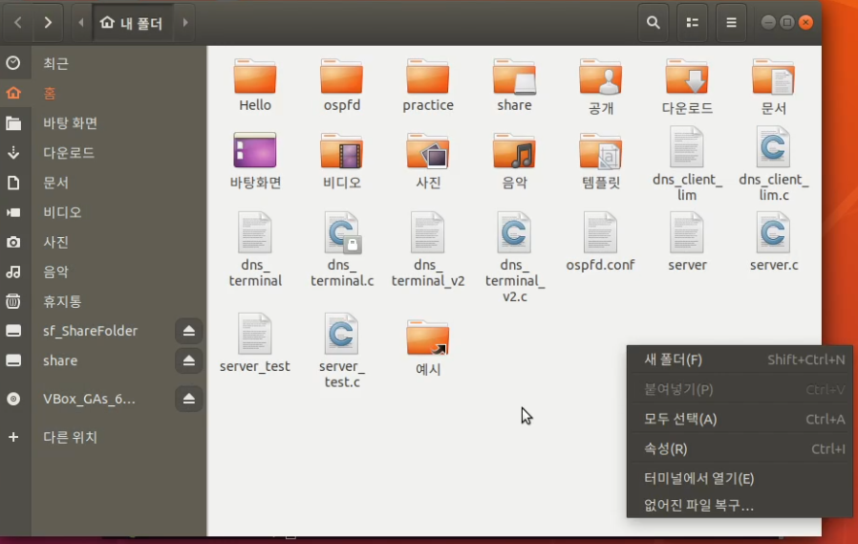
Environment Setup
Make new folder

Slide 16
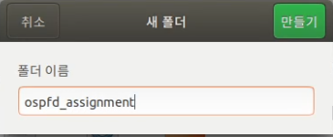
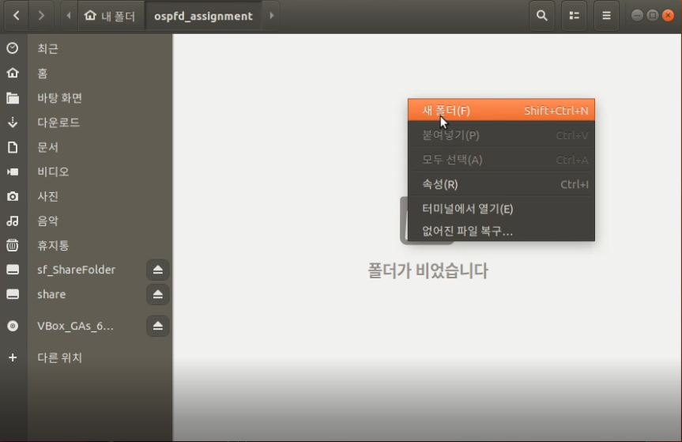
Environment Setup
Folder name is ospfd_assignment
and Click Make
* Don’t change folder name!
Open folder and
Make folder again
Folder name : bin

Slide 17
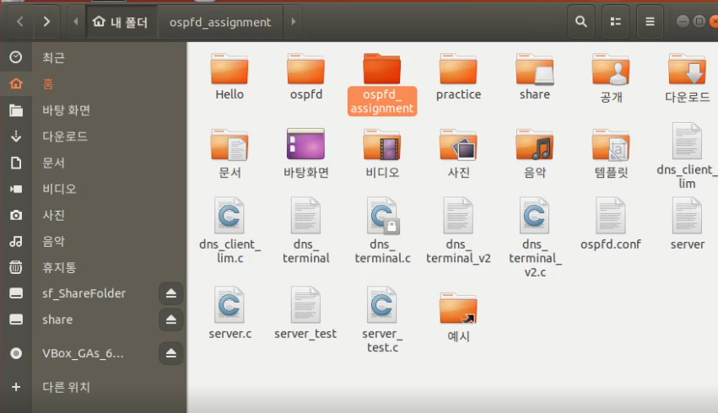
Environment Setup
Return to home
(Click Red box)

Slide 18
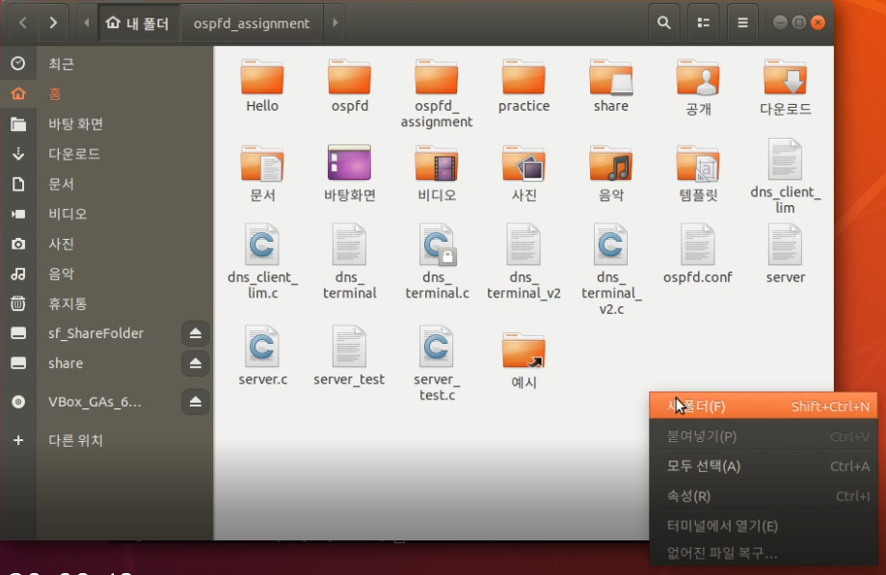
Environment Setup
Folder name is httpd

Slide 19
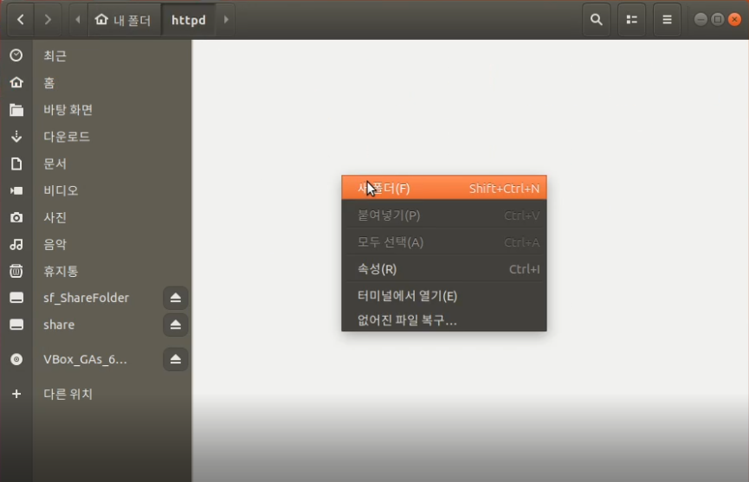
Environment Setup
Open folder and
Make new folder
Folder name is cgi-bin

Slide 20
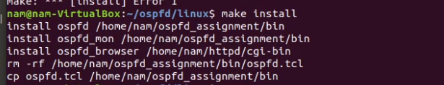
Environment Setup
Type "make install”

Slide 21
Environment Setup

Slide 22
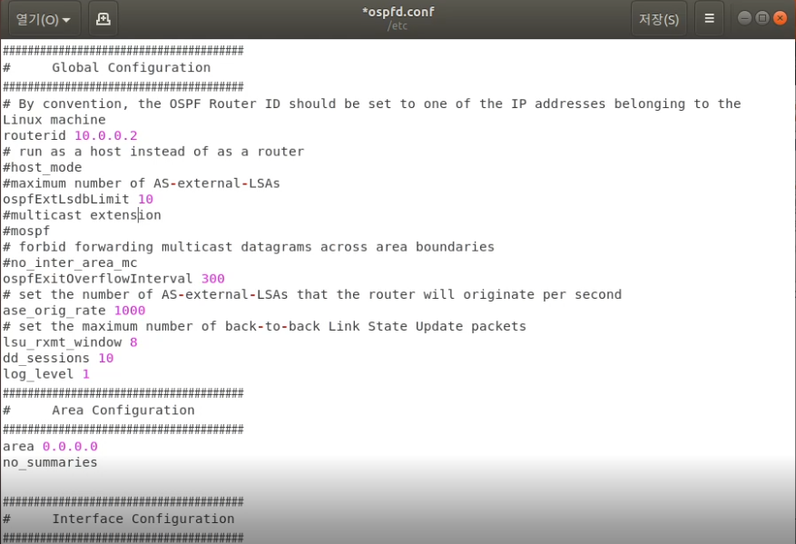
Environment Setup
Change routerid
VM1 - 10.0.0.2
VM2 - 10.0.0.3
VM3 - 10.0.0.4
VM4 - 10.0.0.5

Slide 23
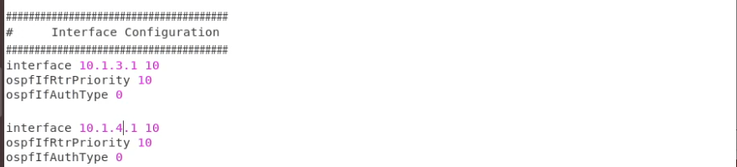
Environment Setup
Set up
interface <IP address1> 10
ospfIfRtrPriority 10
ospfIfAuthType 0
interface <IP address2> 10
ospfIfRtrPriority 10
ospfIfAuthType 0
.
.
.
.
Type that as much as you have interface.

Slide 24
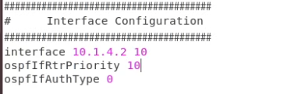
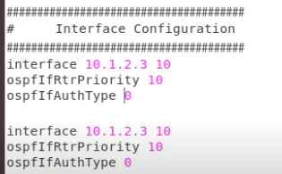
Environment Setup
VM1
VM2
VM3

Slide 25
Environment Setup
Repeat ppt 4~20 on each VM.
(Turn NAT on ~ edit ospfd.conf)

Slide 26
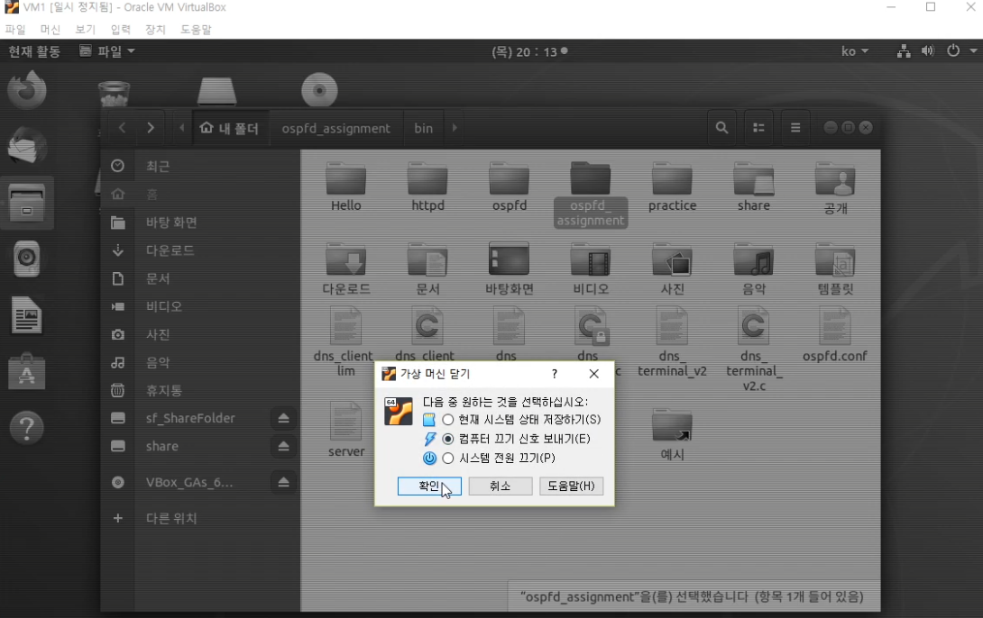
Environment Setup
Turn VM1 off

Slide 27
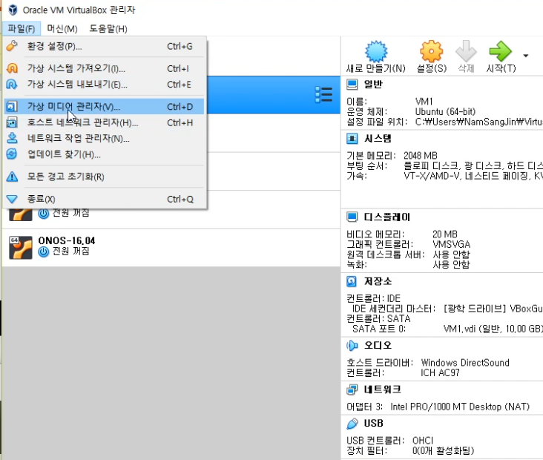
Environment Setup

Slide 28
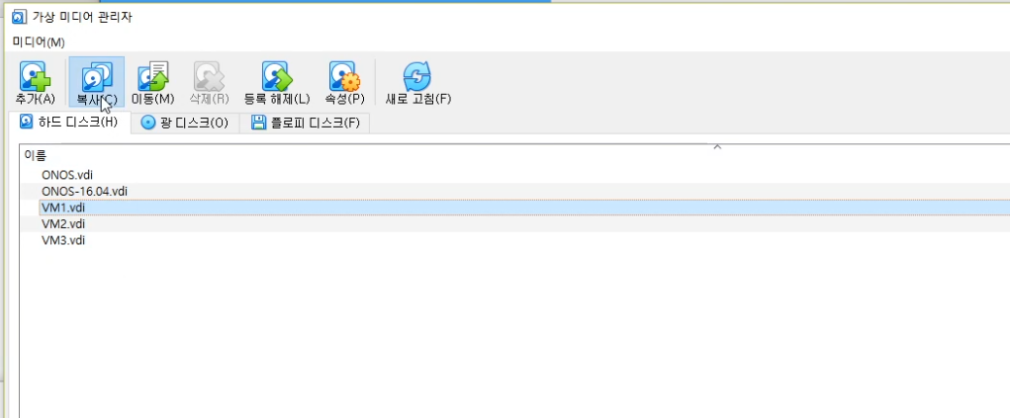
Environment Setup
2
1

Slide 29
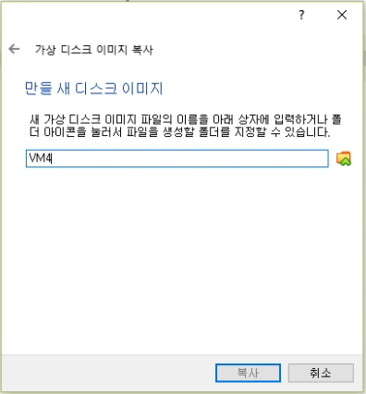
Environment Setup
Click Next Next Next..
Type VM4 as copied image file name

Slide 30
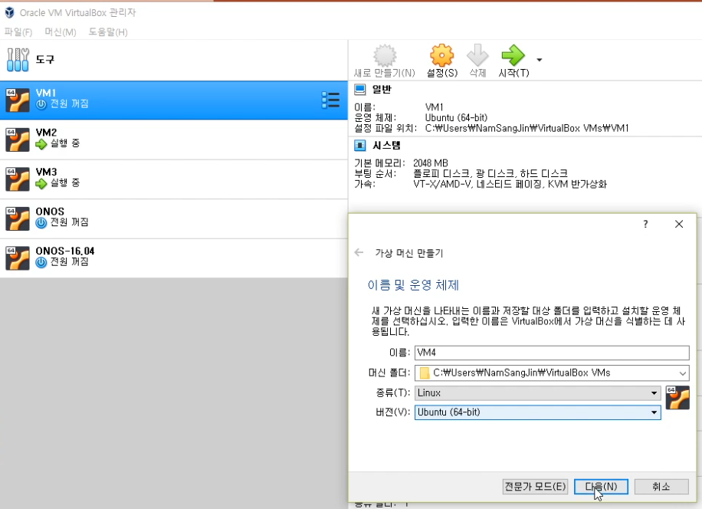
Environment Setup
Click Next and Set up options such as RAM
to make new VM, VM4.

Slide 31
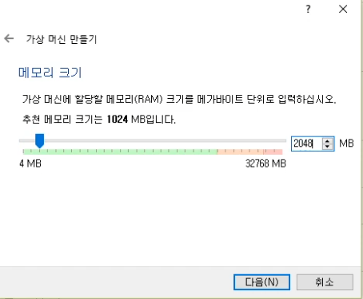
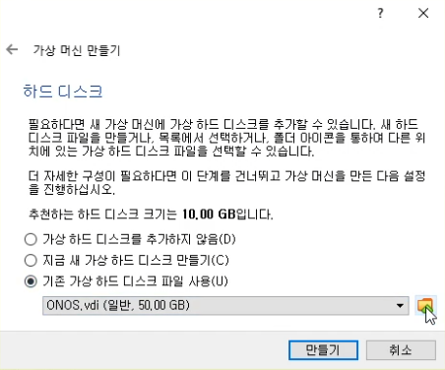
Environment Setup
Input memory size you want

Slide 32
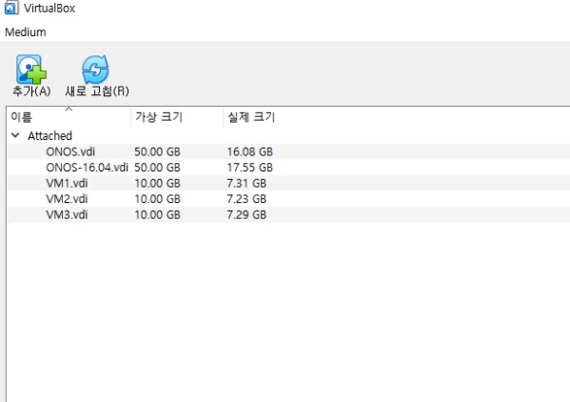
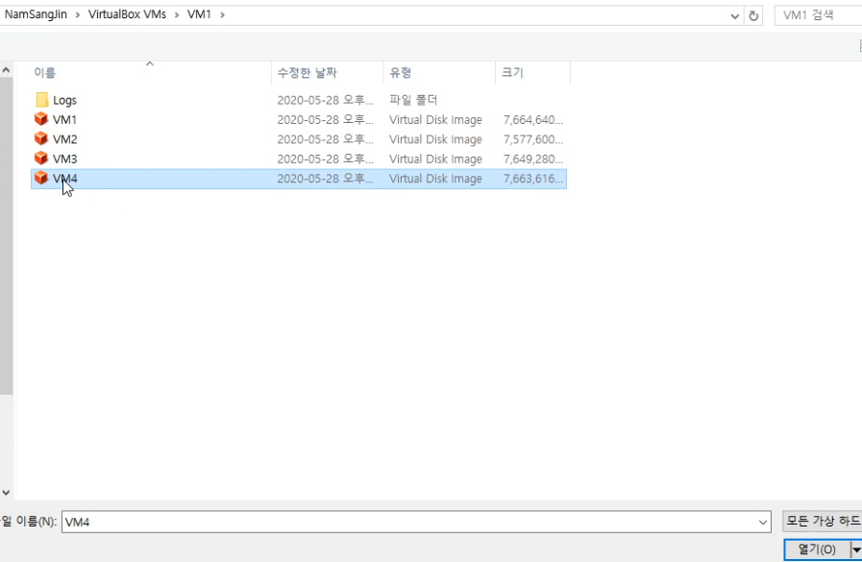
Environment Setup

Slide 33
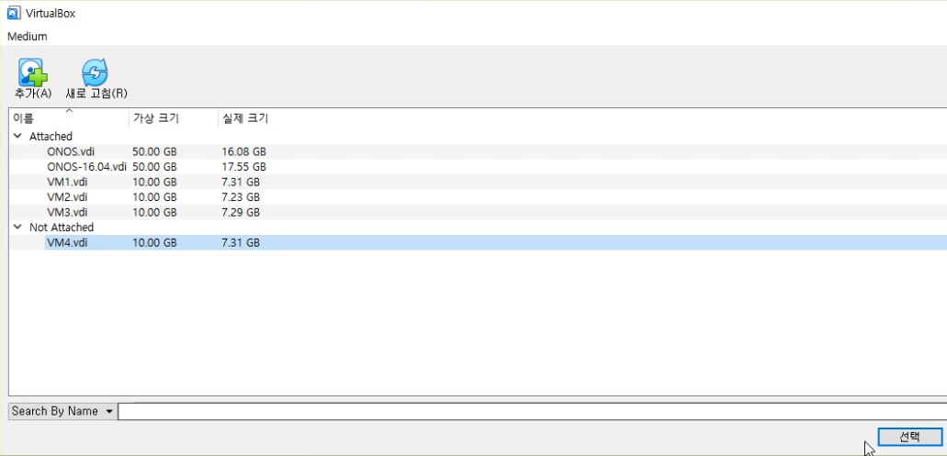
Environment Setup

Slide 34
Environment Setup
Click Make and Set up network setting of each VM. (also turn NAT off.)
10.1.2.0/24
VM3
10.0.0.4
10.1.2.3
10.1.3.3
10.1.3.0/24
VM1
10.0.0.2
10.1.4.0/24
10.1.3.1
10.1.4.1
10.1.3.4
10.1.4.2
10.1.1.0/24
VM4
10.0.0.5
VM2
10.0.0.3
10.1.1.4

Slide 35
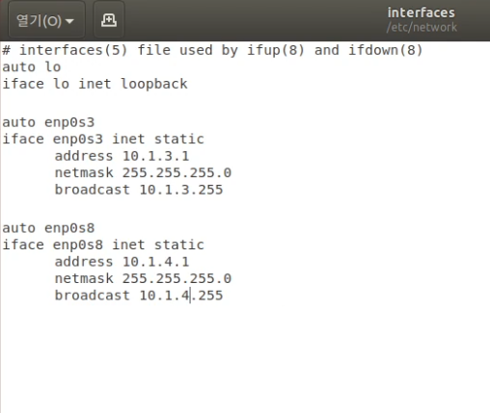
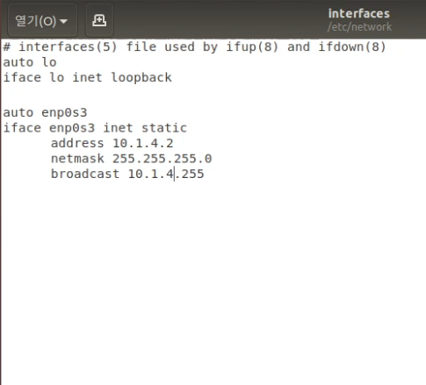
Environment Setup
Turn VMs on.
Edit /etc/network/interfaces on each VM and reboot VMs.
VM1
VM2

Slide 36
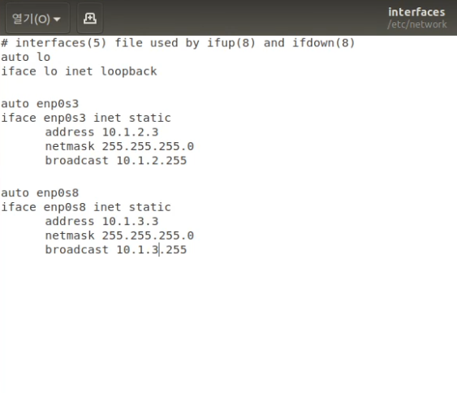
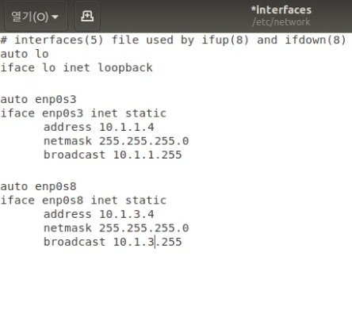
Environment Setup
VM3
VM4
* Please don’t forgot to edit ospfd.conf of VM4

Slide 37
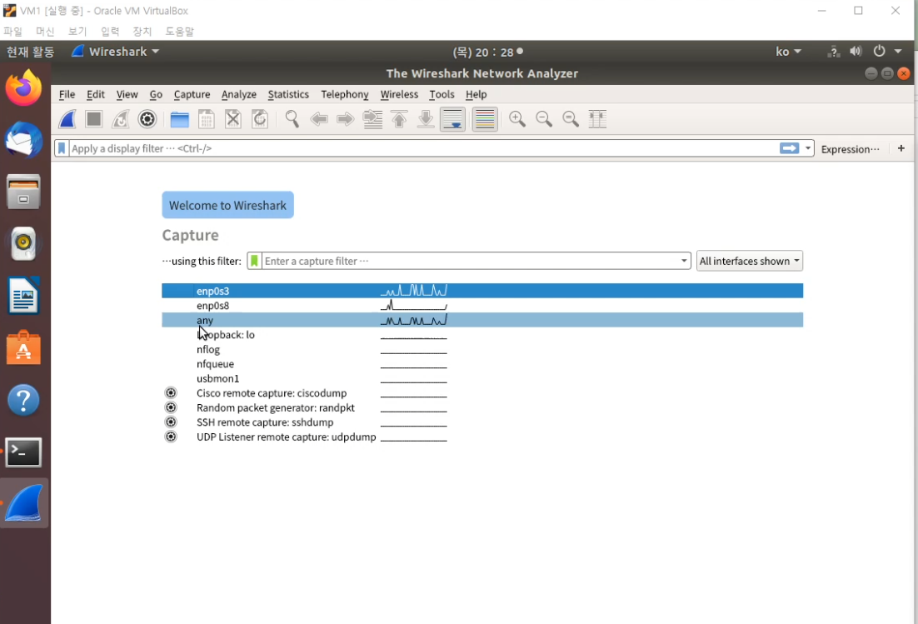
Run wireshark and ospfd
On each VM, run wireshark and select “any“ (we should see packets for two interfaces at a same time.)

Slide 38
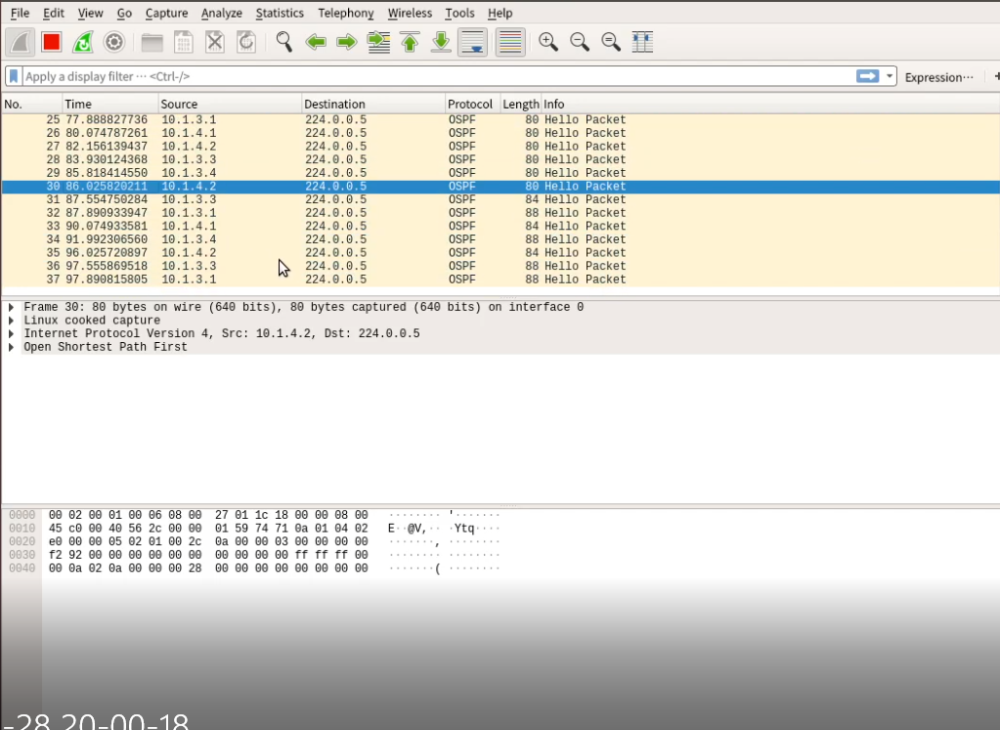
Run wireshark and ospfd
ospf
Type ospf to use filter.

Slide 39
Q & A
nampal02@korea.ac.kr
You can use assignment Q&A room of Collaborate by sending me an e-mail.

